Slide 1
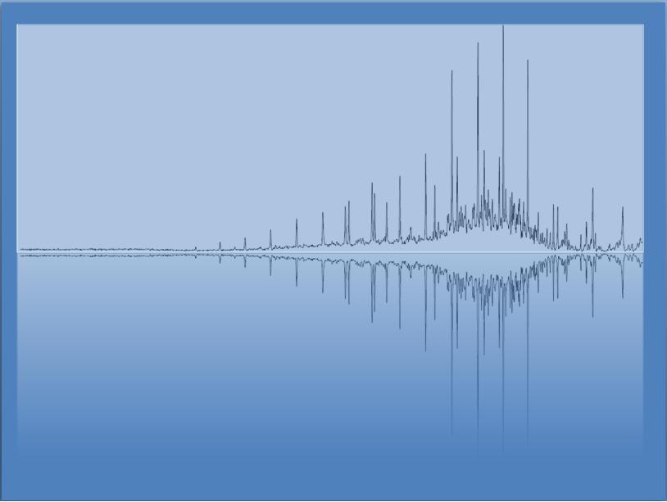
Radioactivity and Nuclear Chemistry
Chem 3A- Yates

Slide 2
Outline
Nuclear Chemistry and Radioactivity
What is Radioactivity?
Discovery and Applications
Nuclear Equations and Modes of Decay
Half Life
Redox Review

Slide 3
What Is Radioactivity?
Radioactive nuclei spontaneously break down into smaller nuclei.
The parent nuclide is the nucleus that is undergoing radioactive decay; the daughter nuclide are the new nuclei that are made.

Slide 4
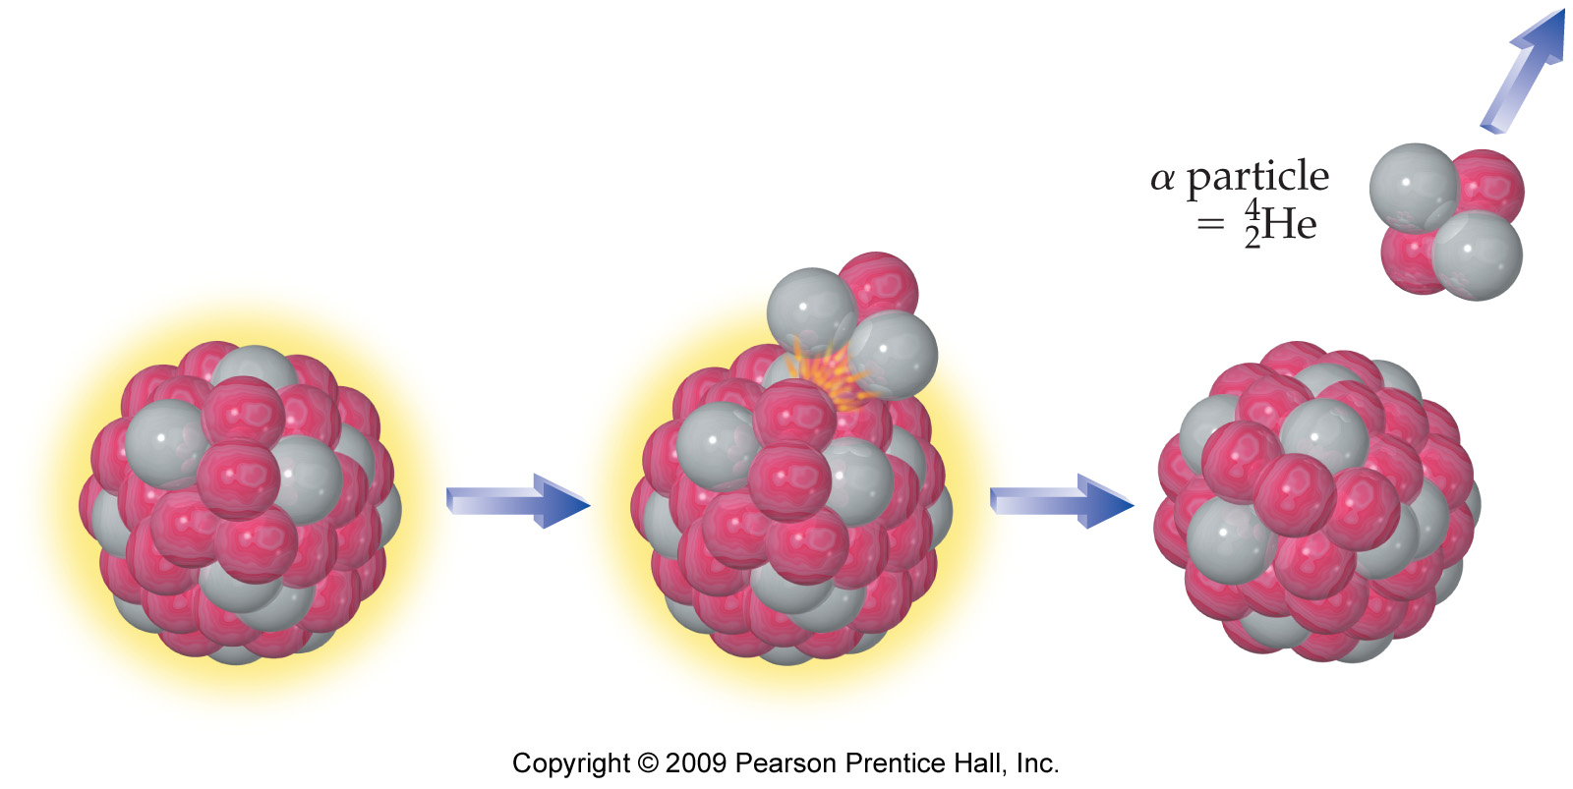
α Decay

Slide 5
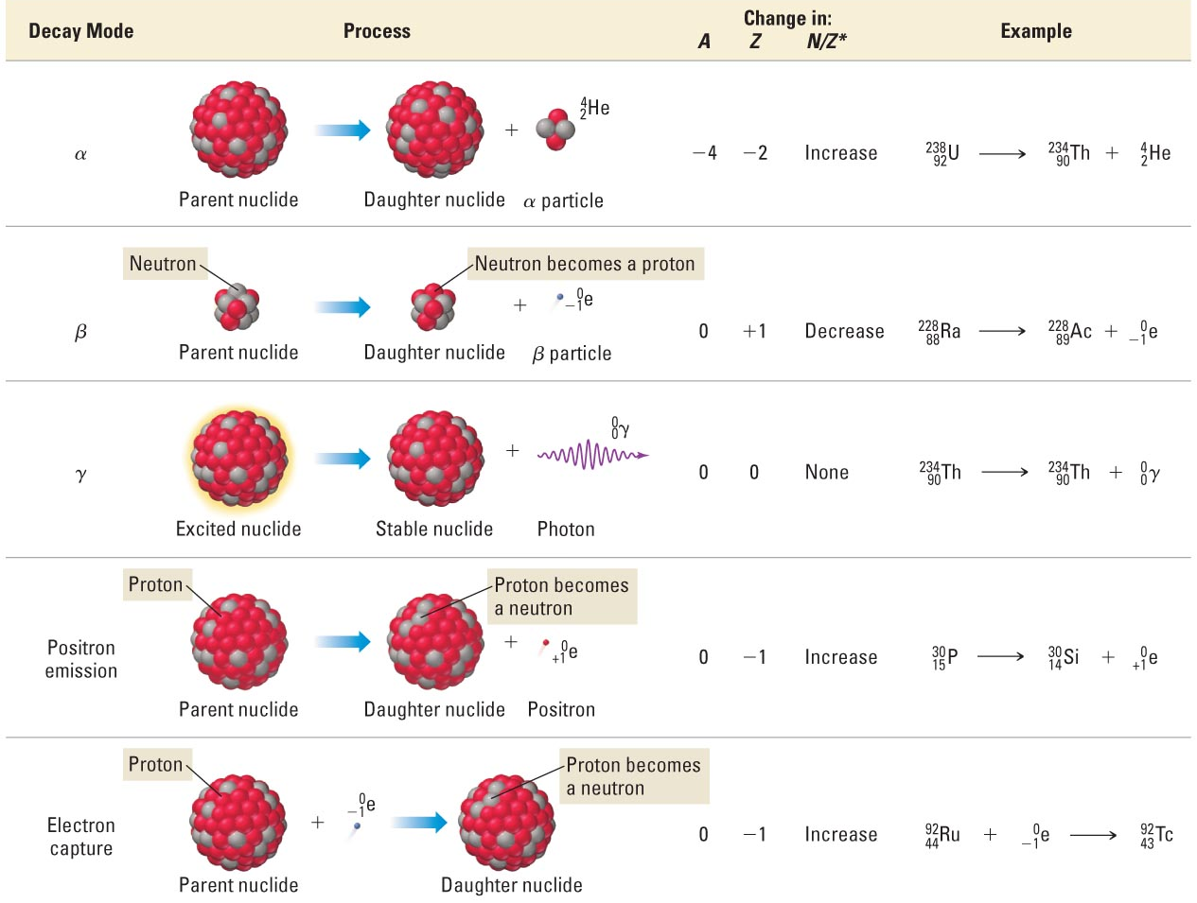
Common Nuclear Decay Modes
*
Memorize for Exam
*
*

Slide 6
Outline
Nuclear Chemistry and Radioactivity
What is Radioactivity?
Discovery and Applications
Nuclear Equations and Modes of Decay
Half Life
Redox Review

Slide 7
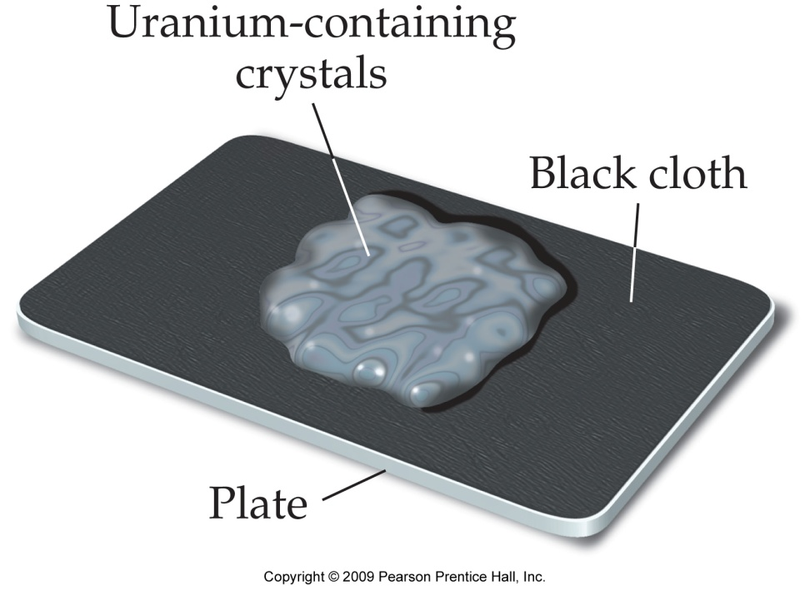
Discovery of Radioactivity -Becquerel
Antoine-Henri Becquerel discovered that uranium released radiation he called
“uranic rays”.

Slide 8
Discovery of Radioactivity –
Marie Curie
When charged, the metal
foils spread apart due to
like-charge repulsion.
When exposed to ionizing radiation, the radiation knocks electrons off the
air molecules, which jump onto the foils and discharge them, causing them to
drop down.
+++
+++
*Marie Curie discovered the radioactive elements
Radium and Polonium.

Slide 9
Rutherford’s Experiment
++++++++++++
γ
β
α
--------------
*Separated Alpha, Beta, and Gamma particles.

Slide 10
Applications of Radioactivity
Dating rocks and fossils (Radiocarbon, etc.)
Generating Power (Nuclear Fission)
The Sun (Nuclear Fusion)
Medicine (Imaging, Radiation treatment for cancer)
The Atomic Bomb
Destroys Human Tissue (Marie Curie Died from radiation poisoning.)

Slide 11
Outline
Nuclear Chemistry and Radioactivity
What is Radioactivity?
Discovery and Applications
Nuclear Equations and Modes of Decay
Half Life
Redox Review

Slide 12
Atomic Notation Review
Mass # (p⁺ + n⁰)
Atomic # (# of p⁺)

Slide 13
Important Atomic Symbols
Particle | Symbol | Nuclear symbol
Proton | p⁺
Neutron | n⁰
Electron | e⁻
Alpha | α
Beta | β, β⁻
Gamma | γ

Slide 14
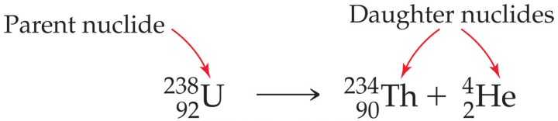
Nuclear Equations
In nuclear equations the atomic numbers and mass numbers are conserved.
Use this fact to predict the daughter nuclide if you know parent and emitted particle.

Slide 15
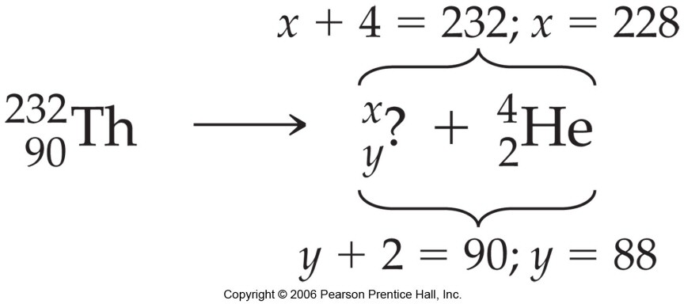
Nuclear Equations
In the nuclear equation, mass numbers and atomic numbers are conserved.
What is the daughter nuclide below.

Slide 16
Write a Nuclear Equation for Each of the Following:
Alpha emission from U-238.
Beta emission from Ne-24.
Gamma emission from N-13.

Slide 17
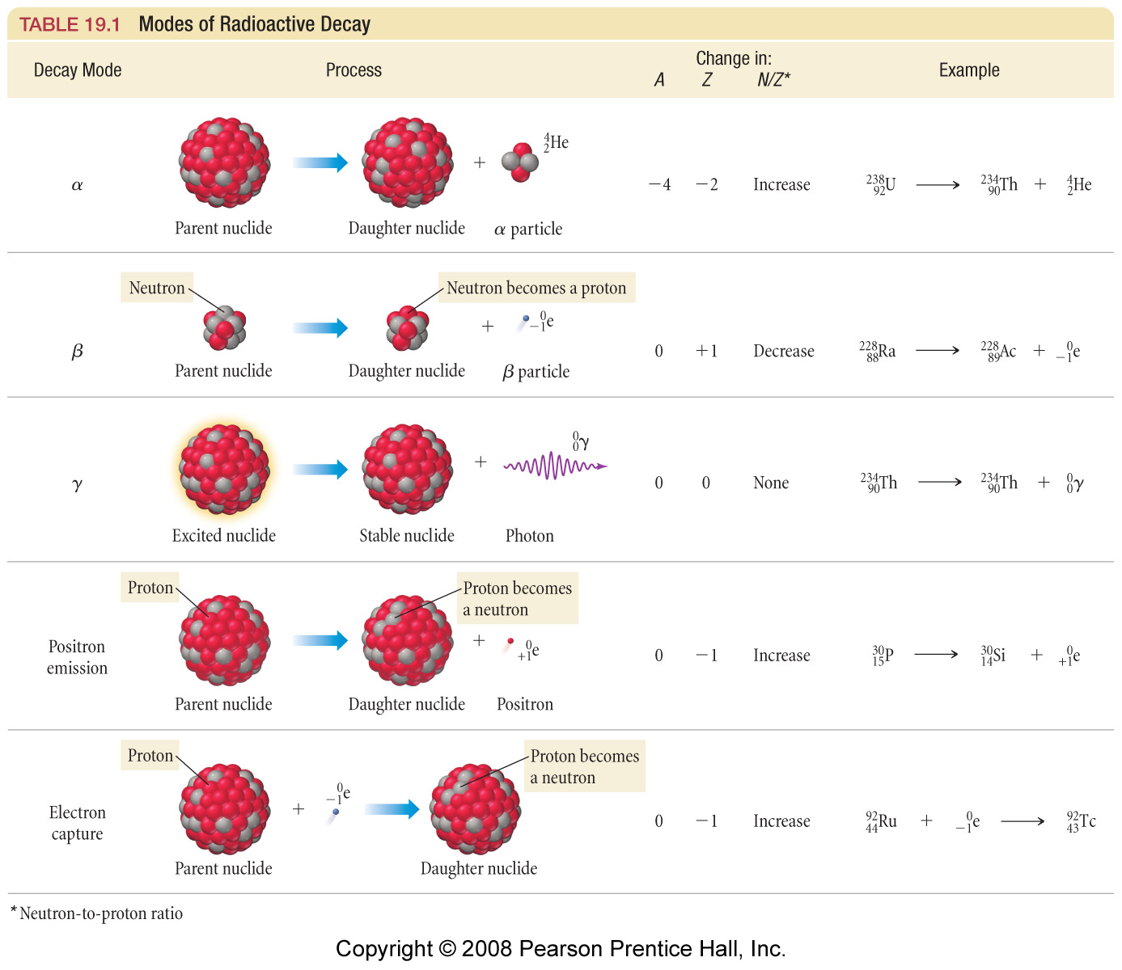

Slide 18
Write a Nuclear Equation for Each of the Following, Continued:
Alpha emission from U-238.
Beta emission from Ne-24.
Gamma emission from N-13.

Slide 19
Complete the following nuclear equation for the fusion of deuterium and tritium
+
+
₁H
₁H
₀n
²
³
¹

Slide 20
Complete the following nuclear equation for the fusion of deuterium and tritium
+
+
₁H
₁H
₂He
₀n
²
³
⁴
¹

Slide 21
Outline
Nuclear Chemistry and Radioactivity
What is Radioactivity?
Discovery and Applications
Nuclear Equations and Modes of Decay
Half Life
Redox Review

Slide 22
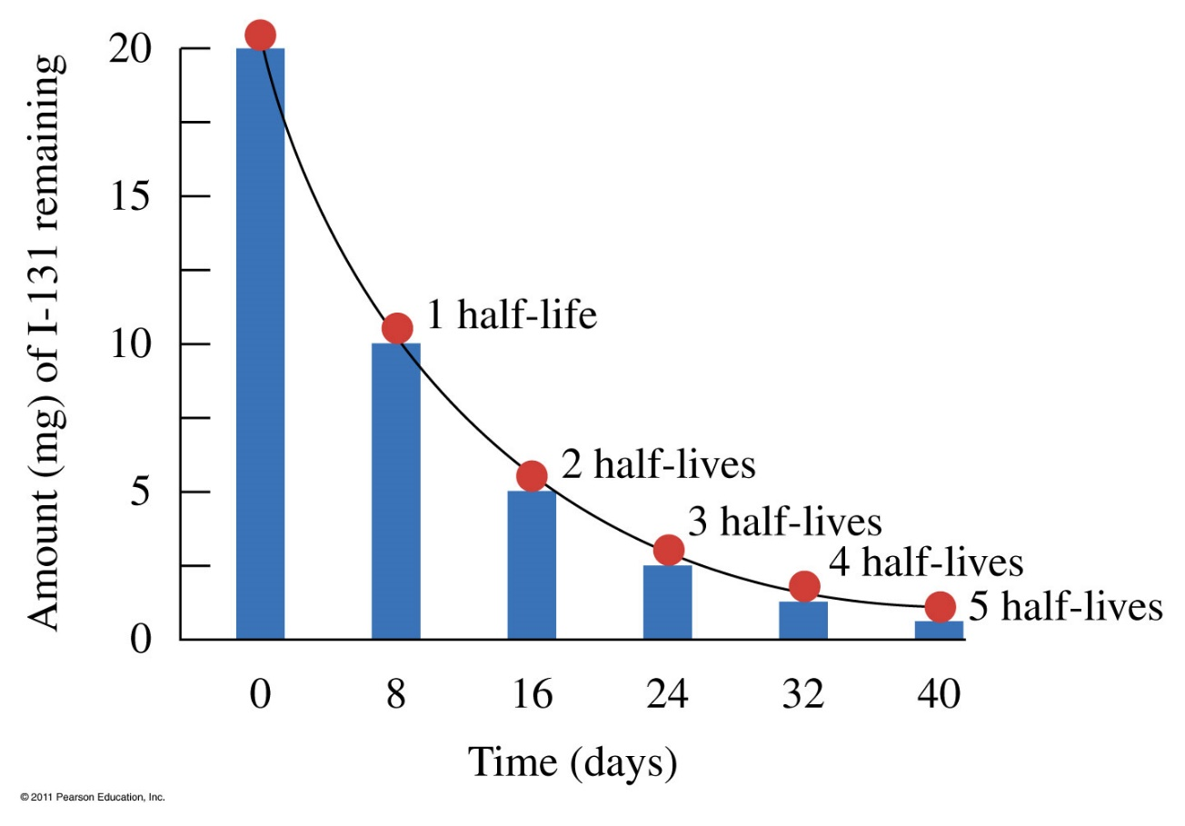
Nuclear Decay Rates
The amount of a radioactive element decreases as individual atoms decay.
Some decay quickly, while others decay slowly.
One common simple way to measure how fast an element decays
is called the
“Half Life”.

Slide 23

Half Life
The length of time it takes for half of the parent nuclides to decay to its daughter nuclide is called the half-life.
1st half-life
2nd half-life
3rd half-life
20 mg
10 mg
5 mg
2.5 mg
8 days
8 days
8 days
16 days
24 days

Slide 24
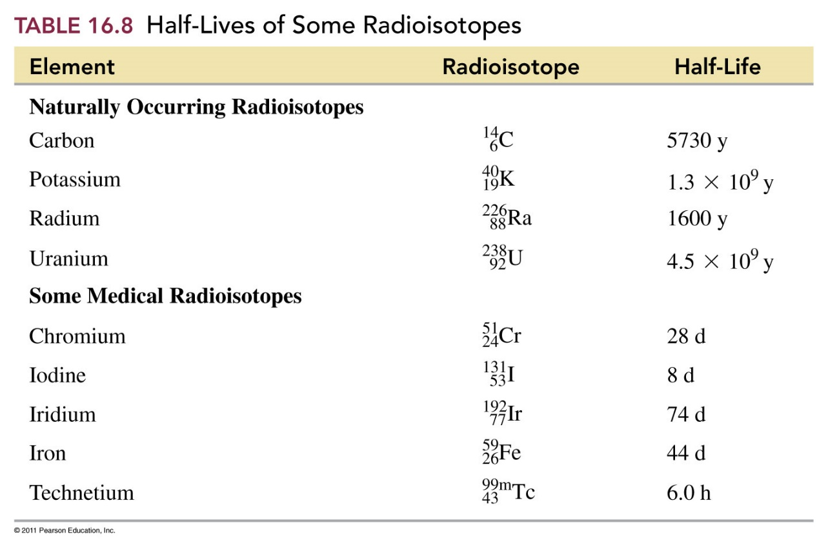
Half Lives

Slide 25
Outline
Nuclear Chemistry and Radioactivity
What is Radioactivity?
Discovery and Applications
Nuclear Equations and Modes of Decay
Half Life
Redox Review
Balancing Half Reactions
The Activity Series, Will a Reaction Happen?

Slide 26
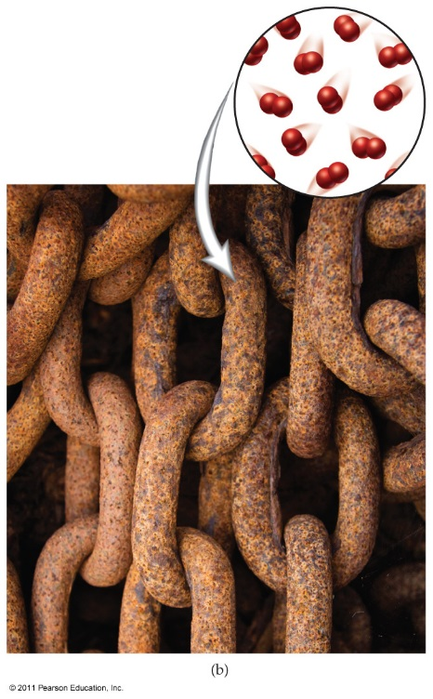
Redox Reactions- Half Reactions
4 Fe(s) + 3 O₂(g) → 2 Fe₂O₃(s)
Fe + _?_ → Fe³⁺ + _?_
O₂ + _?_→ 2 O²⁻ + _?_

Slide 27
Redox Reactions
4 Fe(s) + 3 O₂(g) → 2 Fe₂O₃(s)
Fe → Fe³⁺ + 3 e⁻ : oxidation
O₂ + 4 e⁻ → 2 O²⁻ : reduction

Slide 28
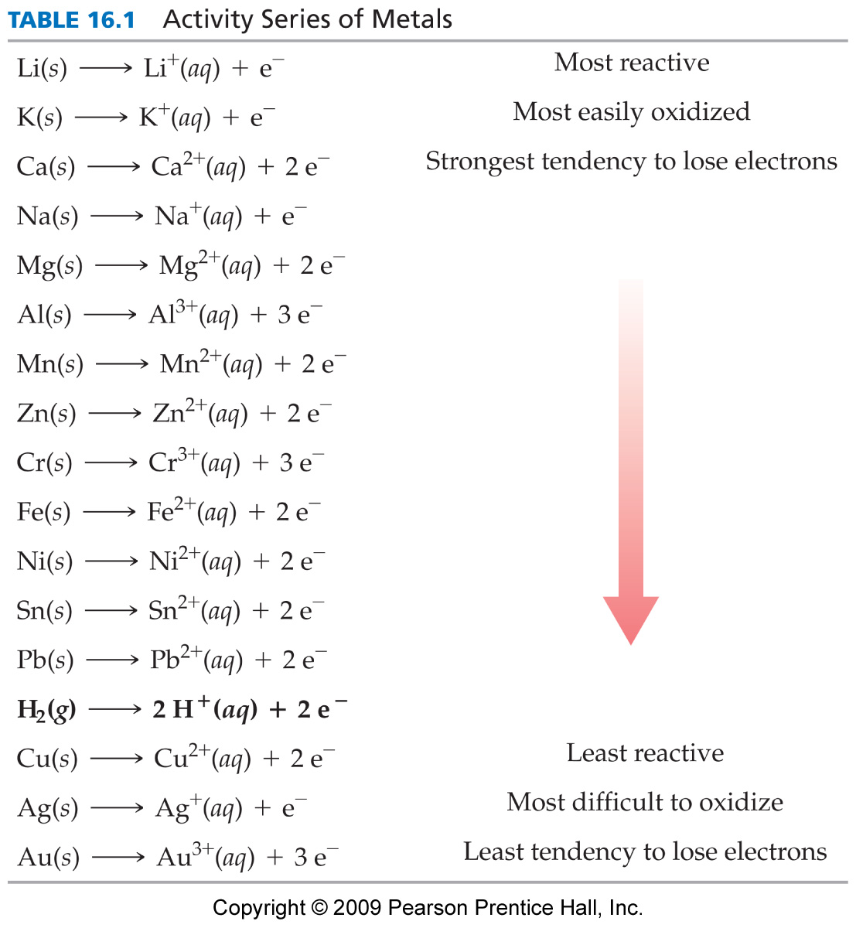
Activity Series of Metals
*Higher elements want to lose electrons to lower elements
Cu + H⁺ → no reaction
Mg + 2H⁺ → Mg²⁺ + H₂ (g)
Zn + Fe²⁺ → Fe + Zn²⁺
Cu + Fe²⁺ → no reaction

Slide 29
Predict the Products and Balance the Equation.
Mg + H₃PO₄ →
Cu + H₂SO₄ →
Al + Fe²⁺ →

Slide 30
Predict the Products and Balance the Equation, Continued.
3 Mg + 2 H₃PO₄ → Mg₃(PO₄)₂ + 3 H₂
Cu + H₂SO₄ → No reaction.
2 Al + 3 Fe²⁺ → 2 Al³⁺ + 3 Fe

